Slide 1

Contemporary World
Dr. Muhammad Kashif

Slide 2
^{7th} Lecture Corruption and Contemporary World
Definition of corruption
Types of corruption
Causes of corruption
Effect Of Corruption
Effects on politics
Effects on Economic

Slide 3
SOME INTERESTING FACTS
54% of Indian users paid a bribe to at least one of nine selected service providers in 2010 – TI,2011
49 % Pakistanis, 11 %Chinese, 62 % Afghans, 4 % Brazilians, 27% Russians, 63 % Nigerians and 31 % Mexicans too paid bribes – TI,2011
In 2012 India has ranked 94th out of 176 countries in Transparency International's Corruption Perceptions Index
India tops the list for black money in the entire world with almost US$ 1456 billion in Swiss banks.

Slide 4
DEFINITION
Giving or obtaining advantage through means which are illegitimate, immoral, and/or inconsistent with one's duty or the rights of others.
Transparency International(TI) define corruption as “ The misuse of entrusted power for private gain”

Slide 5
BEST DEFINITION
Corruption = (Monopoly) + (Discretion) – Accountability or in abbreviated form as: C = R + D – A

Slide 6
DEFINITION
Behaviour that deviates from the formal rule - regarding motives such as wealth, power, or status.
Oxford Dictionary defines corruption as ― “Perversion or destruction of integrity in the discharge of public duties by bribery or favour.”

Slide 7
SOME ILLUSTRATIONS
Design or selection of uneconomical projects because of opportunities for financial kick backs and political patronage,
e.g. Realigning rail track to inflate cost
Illicit payments of "speed money“ to government officials to facilitate the timely delivery of goods and services to which the public is rightfully entitled, such as permits and licenses,
e.g. transfer of govt. lands

Slide 8
SOME ILLUSTRATIONS
Misappropriation of confidential information for personal gain, such as using knowledge about public transportation routings to invest in real estate that is likely to appreciate .
e.g. extension of DMRC, location of SEZ & national highway realignment
Sale of official posts, positions, or promotions; nepotism; or other actions that undermine the creation of a professional, meritocratic civil service.
e.g. State PWD, Irrigation, NHAI & Central Secretariat

Slide 9
TYPES OF CORRUPTION
SYSTEMATIC: Permeate an entire government or ministry.
e.g. DDA&MCD
INDIVIDUAL: Isolated and sporadic.
e.g. Traffic constable & sanitation inspector
GRAND: Senior officials, major decisions or contracts, and the exchange of large sums of money and involves transnational.
e.g.2G Scam & CWG Scam
PETTY: Low level officials, the provision of routine services and goods, and small sums of money.
e.g. licensing & enforcement

Slide 10
We can differentiate corruption in another seven groups
AUTOGENIC : Self generating and involves only perpetrator
DEFENSIVE : Compulsive in nature and victims pay bribes in self defense.
EXTORTIVE : This is compensation in exchange for services.

Slide 11
INVESTIVE : For future reward and no direct favor in present.
NEPOTISTIC : No direct transfer of money. Just preferential treatment to relatives and friends.
SUPPORTIVE : It supports the existing corrupt system.
TRANSACTIVE : Involves both parties and the advantage is for both.

Slide 12
CAUSES OF CORRUPTION
Absolute authority
Ineffective/antiquated and overburdened legal system
Ineffective anti-corruption mechanisms
In adequate enforcement
Lack of employment
Privatization, Liberalization and Globalization

Slide 13

CAUSES OF CORRUPTION
Diminishing values in the society.
Diminishing patriotism.
Lack of awareness.
Low literacy rate.
Lack of effective management.
Lack of economic stability.
Lack of effective political leadership.

Slide 14
CAUSES OF CORRUPTION
The very presence of black money:
The existence of large amount of unaccounted black money is one of the main sources of corruption.
This money is obtained by various ways,namely,tax evation,smuggling,speculation in immovable propertyand shares and stocks

Slide 15
CAUSES OF CORRUPTION
Economic insecurity:
This is regarded as most important cause of corruption.
The poor people become corrupt in hope of becoming rich.the rich indulge in it for fear of losing what they have
High rate of income tax:
Since tax rates are comparatively high in pakistan even the honest people are often tempted to escape from it by making false returns of their property and income many of officers in income tax department

Slide 16
Are also equally corrupt ant they thrive on bribery
Meager salary being paid to government servants:
Employees in some of the government departments are paid comparatively very less salary this situation is said to be cause of corruption in administration
The system of democracy:
The present style of functioning of democracy in Pakistan also contributes to corruption. all parties

Slide 17
Specially ruling party spends crores of rupees on each election. This money comes from businessmen, industrialists and other rich persons.
They supply money to the party in the form of black money and this in turn gives them licence, a ‘moral’ justification for accumulating money in different forms

Slide 18
CONSEQUENCES OF CORRUPTION
Loss of National wealth
Hindrance and obstruction in development
Backwardness and Poverty
Authority and power in wrong hands
Brain drain
Inflation

Slide 19
CONSEQUENCES OF CORRUPTION
Inferior public infrastructure
Loss of faith in democracy
Psychological and social disorders
Environmental degradation
Rise of anti social elements

Slide 20
CURES FOR CORRUPTION
Value education
Strong Legislation
Responsible citizen
Effective leadership and administration
Effective and regular vigilance
Strong Media support( through films, ads, serials)

Slide 21
CURES FOR CORRUPTION
Loyalty and patriotism
Transparency appointment and admissions
Declaration of wealth and assets
Dedicated and diligent political leaders
Coordination and control of agencies
Social organisation

Slide 22
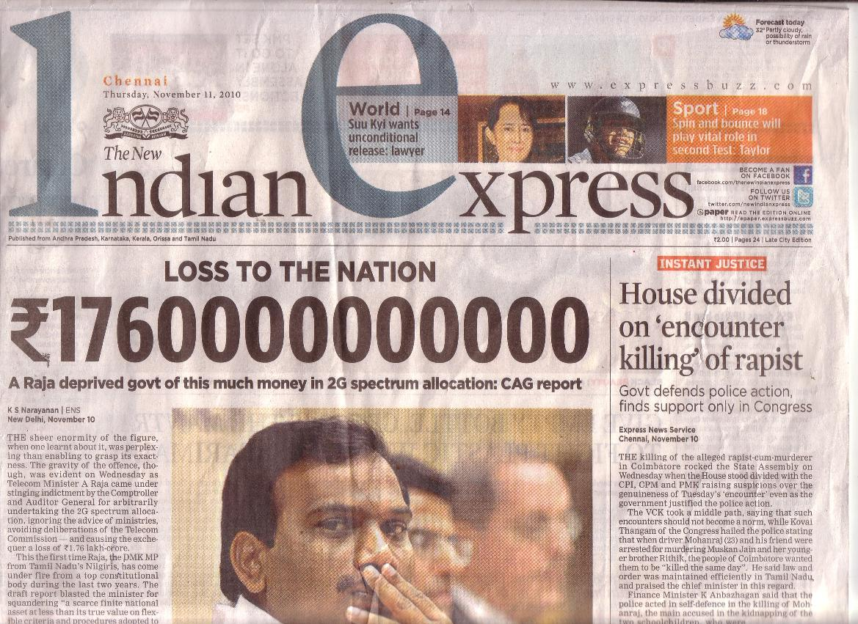
TOP CORRUPTION SCAMS IN INDA
2G spectrum Scam
The 2G spectrum scandal was a political scandal that occurred in India in 2010–11 where officials in the government of India were illegally undercharging mobile telephony companies for frequency allocation licenses, which they would use to create 2G subscriptions for cell phones. The difference between the money collected and the money which the law mandated to be collected is estimated to be 176,645 crore

